Slide 1
APUSH Review: Period 5 In 10 minutes!
Everything You Need To Know About Period 5 in 10 minutes!

Slide 2
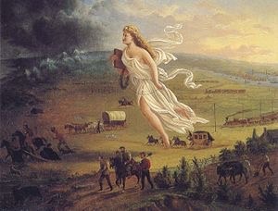
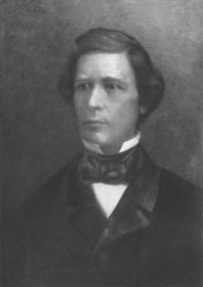
US Expansion
Manifest Destiny:
Based on racial and cultural superiority
Main focus of political debates
Acquiring territory:
Mexican-American War: Mexican Cession
Enormous debates over slavery - Wilmot Proviso
Impacts of expansion?
Environmental changes, settlement of Indian lands
Initiatives towards Asia:
Economic: Matthew Perry
Cultural: Missionaries

Slide 3
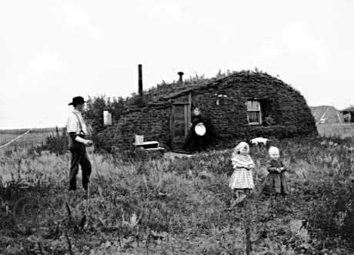
US Expansion
Old Immigrants:
Lived in ethnic communities
Irish in cities, Germans on the frontier
Came to America pre-Civil War
Faced nativism -> anti-Catholic and sought to limit their power and influence
Know-Nothing Party
Opportunities out West:
Increased due to legislation promoting economic development
Homestead Act (1862) - 160 acres of cheap land to move out West and settle for 5 years
Impacts of migrant and territorial expansion?
Conflicts with Hispanics and Natives
Sand Creek Massacre - CO militia attacked Cheyenne Indians, killed over 100, mostly women and children
Little Big Horn (Custer’s Last Stand)- Natives attacked and killed Custer and his men

Slide 4
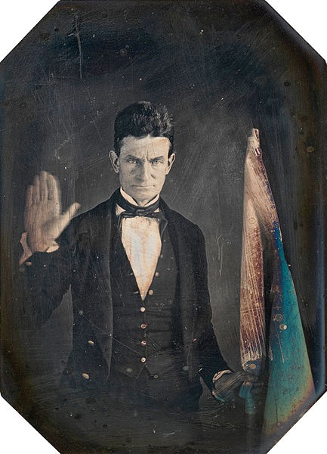
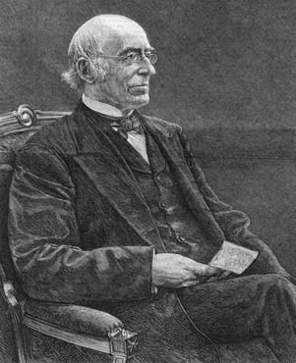
Northern and Southern Differences
North - free labor manufacturing, South dependent on agriculture and slavery, with a slow population growth
As a result, the North has more power in the House
Abolitionists:
Small number in the North, although had a visible campaign
Used fierce arguments (William Lloyd Garrison)
Helped slaves escape (Underground RR)
Used violence (John Brown)
How did the South defend slavery?
“Positive Good”
Nullification - belief that states could declare federal laws unconstitutional
Racist stereotypes - minstrel shows

Slide 5
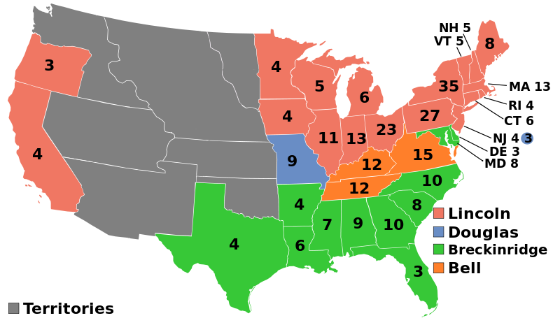
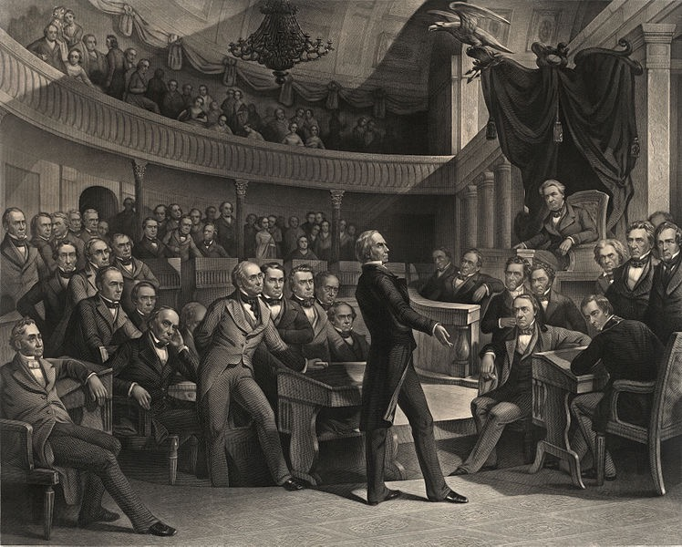
Compromises and Election of 1860
Various failed attempts at solving the issue of slavery?
Compromise of 1850 - dealt with land gained from Mexican Cession
Popular sovereignty and a strict fugitive slave law
Kansas-Nebraska Act -> “Bleeding Kansas”
Dred Scott decision
Causes of the End of the second party system?
Issues over slavery
Anti-immigrant nativism - Know-Nothing Party
Emergence of sectional parties - Republicans in the North and Midwest
Election of 1860:
Lincoln was elected on a free soil platform
Immediate cause of secession, which led to the Civil War

Slide 6
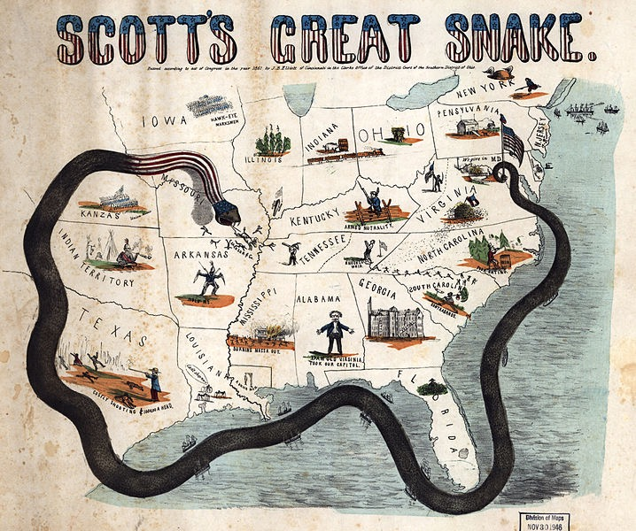
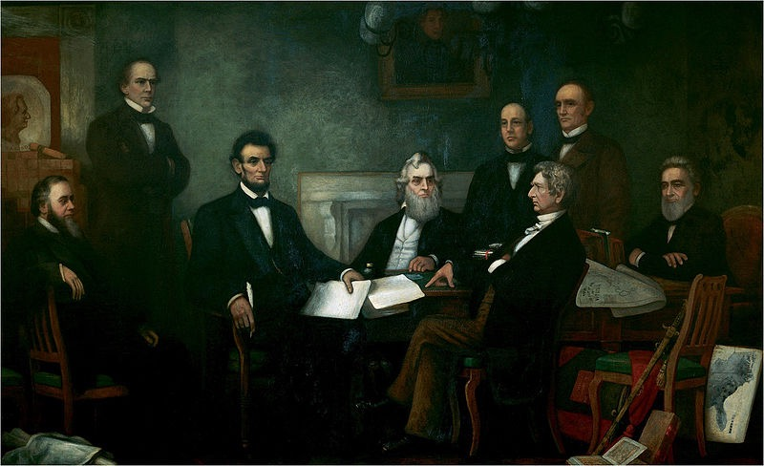
Union Victory In The Civil War
North and South mobilized their economies and societies for the war effort, even in the face of opposition
Both instituted conscription (draft)
Lincoln suspended habeas corpus in MD
Emancipation Proclamation - changed the purpose of the war - no longer to just preserve the Union
Helped keep Europe out of the war
African Americans fought in the Union Army
Could be compared with the Gettysburg Address
Why did the Union succeed?
Improved military leadership - Grant and Sherman
Effective strategies - Anaconda Plan
Key Victories - Antietam, Gettysburg
Greater resources - more factories and railroads
Destruction of the South’s environment and infrastructure - “March to the Sea”

Slide 7
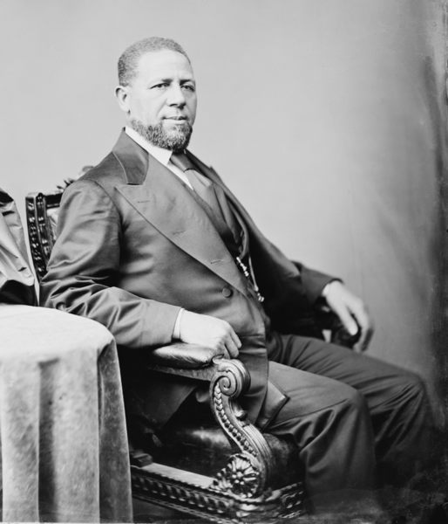
Reconstruction
13th Amendment - abolished slavery
Drastic social and economic change
However, sharecropping endured in much of the South
Impacts of Radical Republicans?
Change in balance of power between Congress and President - impeachment of Andrew Johnson
Former slaves and African Americans gained political opportunities
Hiram Revels - first African American elected to Congress
Waning - To reduce, by the 1870s, the North’s resolve for Reconstruction was waning
Compromise of 1877 ended Reconstruction - the military was withdrawn from the South, Hayes became president

Slide 8
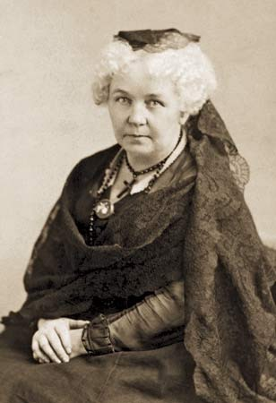
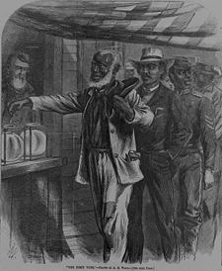
Constitutional Amendments
14th amendment - provided citizenship and equal protection of the laws
15th amendment - suffrage for men
However, African American rights were limited through:
Segregation - Jim Crow laws
Violence - KKK, White League
Supreme Court Decisions (Plessy v. Ferguson, Civil Rights Cases)
Local Political Tactics - poll taxes, literacy tests, and grandfather clauses
Impact of these amendments on women’s rights?
Split the group - some only advocated the 15th amendment if it included women - Elizabeth Cady Stanton and Susan B. Anthony
These amendments were stalled for many decades, but were used in the 1950s and 60s Civil Rights Movement

Slide 9
Quick Recap
Manifest Destiny and its impacts
Mexican-American War and debates over slavery
Immigrants and nativism
Abolitionist tactics
Compromise of 1850, Kansas-Nebraska, and Dred Scott
Election of 1860 and Lincoln’s platform
Emancipation Proclamation and how it changed the war
EVERYTHING about the 13 - 15 amendments
End of Reconstruction and waning

Slide 10
Short Answer Practice
Answer All 3 Parts:
Briefly explain one political or social impact brought about by one of the Reconstruction amendments
Briefly explain one way Southern societies sought to limit the power of the amendment chosen in part a
Briefly explain why Southern societies were or were not successful in limiting the amendment, using specific historical evidence

Slide 11
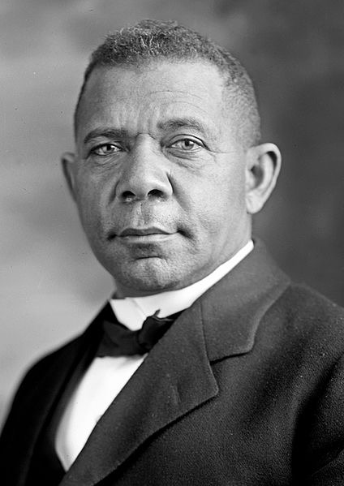
See You Back Here For Period 6 In 10 Minutes!
Thanks for watching
Please subscribe, share with others
Check out my other videos
Best of luck this year!

